Slide 1
Solid Principles and Design Patterns

Slide 2
Objectives
To understand the main principles in refactoring classes
Leading into Design Patterns which embody those principles
Chapter Contents
Some common design patterns
Symptoms of a degrading design
Common design patterns - SOLID
Single-Responsibility Principle
Open/Closed Principle
Liskov Substitution Principle
Interface Segregation Principle
Dependency Inversion Principle
Contents

Slide 3
Follow these principals and you'll have a good chance of delivering good design and code
Single Responsibility
Open-Close
Liskov Substitution
Interface Segregation
Dependency Inversion
Solid principals to rescue

Slide 4
Single Responsibility Principle
Each class should have only one responsibility
Each class should have only one reason to change its behavior
No 'Kitchen Sink' classes.
A class called QA which has all the methods needed to run QA!
This principal promotes decoupling.
If you want to change an aspect, you'll have a lot less code changes
Code is reusable; by combining responsibilities other classes won’t be able to use a single responsibility from the class.
If you've a large class the chances are it's multiple responsibilities
Just break it up into smaller classes which in turn makes the class easier to test.

Slide 5
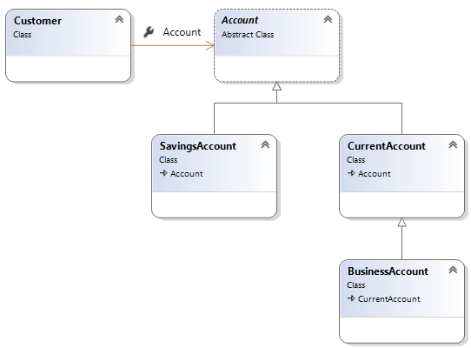
Open Closed Principle
Open for extension, closed for modification.
Software entities should be extendable, but not modifiable.
Changes in requirements are performed using extension rather than modifying existing classes
Apply abstraction and polymorphism.

Slide 6
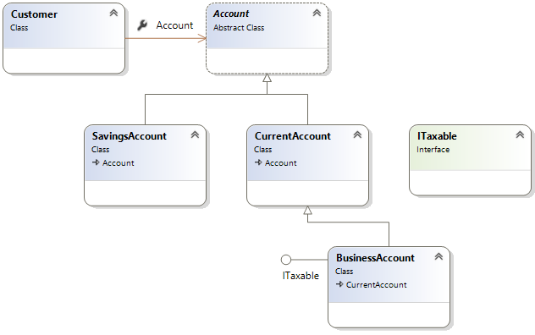
Open Close principal example

Slide 7
Liskov Substitution
Sub-classes behaviour should be the same as the super-classes
Should fulfil all behaviours of the base class correctly.
The behaviour of a derived class should have a stronger post-condition and a weaker precondition than the base class.
(you'll see this in the next few slides)
Liskov substitution principal prevents classes having undesirable behaviours.

Slide 8
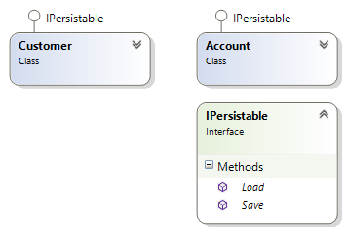
A simple example of the Liskov Principle
interface IPersistable {
void Save();
void Load();
}
class Customer implements IPersistable {
int id;
String name;
public void Load() {
// Read a data store and set // the ID and Name properties
}
public void Save() {
// Save instance properties to a permanent data store
}
}

Slide 9
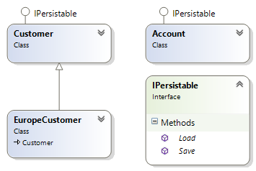
Add a new class called EuropeCustomer
class EuropeCustomer extends Customer
{
public void Load()
{
// Load object data
}
@override
public void Save()
{
if (DateTime.Now.Hour < 12)
{
// Save instance properties
}
}
}

Slide 10
Now let's try a new Customer class
What happens if one of the objects in the List is an EuCustomer?
class Manager
{
public void SaveObjects(ArrayList<IPersistable> objects)
{
for(IPersistable item : objects)
{
item.Save();
}
}
public void LoadObjects(ArrayList<IPersistable> objects)
{
for (IPersistable item : objects)
{
item.Load();
}
}
}

Slide 11
High-Level modules should not depend on low-level modules – both should depend on abstractions
Abstractions should not depend on details. Details should depend on abstractions.
Instead of working with hard-wired / highly coupled classes you should always attempt to use interfaces
Let's have a look at a simple example
Dependency Inversion Principle (DIP)
Notes:
You can think of DIP as being an outgoing interface of the ‘dependent’ class rather than an incoming interface of the dependee class. You have to try and establish the abstraction that underlies the application – that set of concepts and behaviours that doesn’t vary when the details are changed.
This is such an important principle that a mechanism has been subsumed into the .NET framework – delegates do exactly this.
It is also sometime known as “The Hollywood Principle” – don’t call us, we’ll call you.

Slide 12
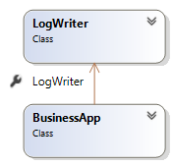
DI example – Bad design
The following code logs message in a console
But the higher level class (BusinessApp) has a dependency on a concrete class (LogWriter)
This violates the DI principle
What if you want to send email instead?
class LogWriter {
public void Write(String message) {
qa_WriteAllText("Log.txt", message);
}
}
class BusinessApp {
LogWriter logger = new LogWriter();
public void Log(String message) {
logger.Write(message);
}
}

Slide 13
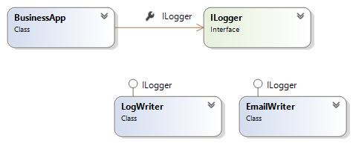
DI Example – Better design
The BusinessApp now depends on abstractions (ILogger interface)
BusinessApp has now got the freedom to Log messages using emails

Slide 14
The C# Code for our DI first attempt
interface Ilogger {
void Write(String message);
}
class LogWriter : Ilogger {
public void Write(String message) {
qa_WriteAllText("log.txt", message);
}
}
class EmailWriter : Ilogger {
public void Write(String message) {
Outlook.Send("admin@qa.com", message);
}
}
class BusinessApp {
ILogger logger;
public void Log(String message) {
if (logger == null)
logger = new LogWriter();
logger.Write(message);
}
}
Could improve!

Slide 15
Dependency Injection (!= Dependency Inversion)
Is for injecting the concrete implementation into a class that uses an abstraction (like an interface)
You can inject dependencies in a Method/Constructor/Property
public class BusinessApp {
ILogger logger;
public BusinessApp(ILogger messageLogger) {
logger = messageLogger;
}
public void Log(String message, ILogger messageLogger) {
logger.Write(message);
}
}
static void Main(String[ ] args)
{
BusinessApp app = new BusinessApp(new EmailWriter());
// other code
}

Slide 16
Interface Segregation
Interfaces should be specific to a client. Many specific interfaces are better than one general purpose interface.
By using specific interfaces, it will present a clear understanding on what behaviours the client should use.
Additionally segregating interfaces increases usability of interfaces as interface implementers should only use behaviours that are relevant.
Let's have a look at an example…

Slide 17
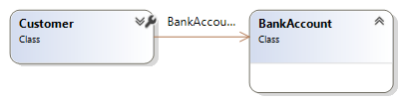
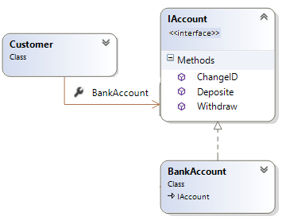
Customer association to a bank account
First attempt: What could be the problem with this design?
Second attempt: Is this solution better? Why?
Yes! Customer can extend another class
But what could be a problem with this solution?

Slide 18
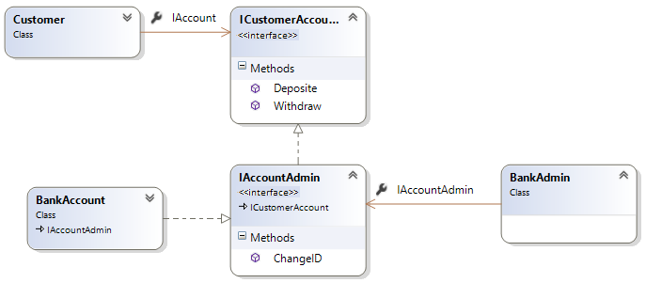
Third attempt – Create many interfaces
We should not allow customers to change their account ID!
How would you solve this problem?
The answer is to give customers their own account interface
The bank should have the ability to change IDs and also have the same capabilities as a customer

Slide 19
What is a pattern?
is a general reusable solution to a commonly occurring problem within a given context
Provides a template for solving problems
Creates a communication shortcut with other designers and speed up the development process
Patterns

Slide 20

A few common patterns
Singleton
This pattern is used to create a single instance of a class in your application
For example, there should only be one Game object in a Game application, One Bank object in an application about Bank
Factory
Creates other objects
Often used with a Singleton patterns because one instance of factory will be enough in most applications
Abstract factory
Like Factory, but it can create families of related objects
Composite
Treats individual objects and compositions of objects uniformly
Decorator
Attach additional responsibilities to an object dynamically keeping the same interface. Provides a flexible alternative to subclassing for extending functionality.
There are many more
See here for more information:
https://refactoring.guru/design-patterns/csharp

Slide 21
Design Patterns embody principles
They are a great way of grasping and implementing principles in your design/code
You have to strike a balance between:
How do you find that balance? – next slide…
Too simple Easier to hack than follow the design Rigid/Fragile/Repetitive etc.
Needless Complexity

Slide 22
…by Unit Test
Exposes software that should be de-coupled
We naturally put responsibilities together
Software design is largely about separating the responsibilities that are subject to change
You don’t want to do it if the change never happens
When you do have to do it, you want to do this just once
I.e. take the first bullet then refactor so the following bullets don’t hurt
Never say “we’ll come back and fix that later
Agile design is a process, not an event
Unit Test is probably the best tool we have for driving good design

Slide 23
Symptoms of a degrading design
Rigidity, fragility, immobility, viscosity
Degradation of dependency architecture
SOLID
SRP / OCP / LSP / ISP / DIP
Review

Slide 24
THANK YOU
Hope you enjoyed this learning journey.

